Slide 2
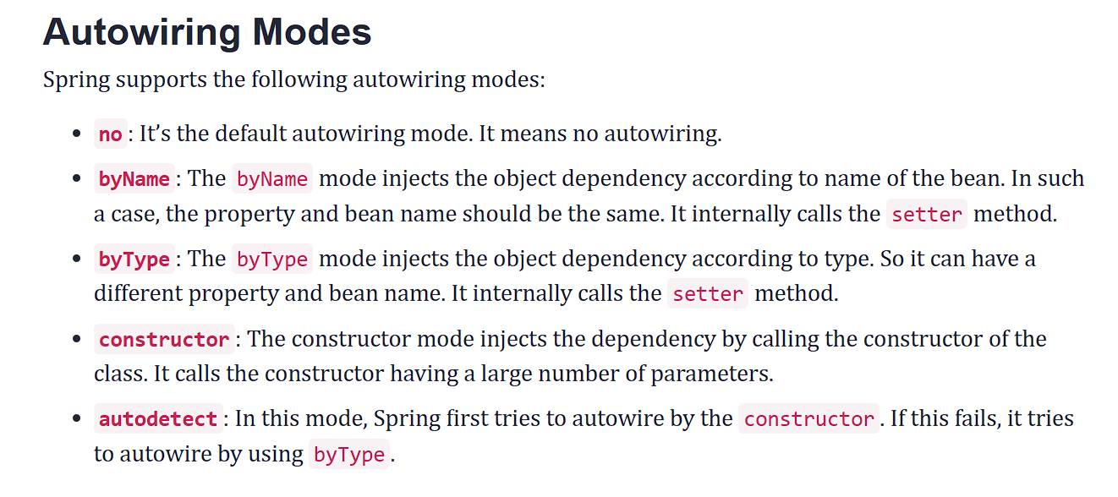

Slide 3
Spring?
Spring is a popular open-source framework for building enterprise Java applications. It provides comprehensive infrastructure support for developing Java applications, facilitating easier development, and testing through features like dependency injection, aspect-oriented programming, and more.
What is Spring Boot?
Spring Boot is an extension of the Spring framework that simplifies the process of building stand-alone, production-grade Spring-based applications. It aims to eliminate the boilerplate configuration required in traditional Spring applications by providing auto-configuration and opinionated defaults. Spring Boot enables developers to quickly set up and deploy Spring applications with minimal setup.

Slide 4
XML Configuration vs. Annotation
In Spring, there are primarily two ways to create beans: XML configuration and annotation-based configuration. While XML configuration provides a structured approach, annotation-based configuration offers a more modern and concise way to define beans.
Annotation-Based Bean Creation
In Spring, annotations are used to declare beans and their dependencies. Annotation-based bean creation involves annotating classes with specific annotations to indicate that they are Spring-managed components.

Slide 5
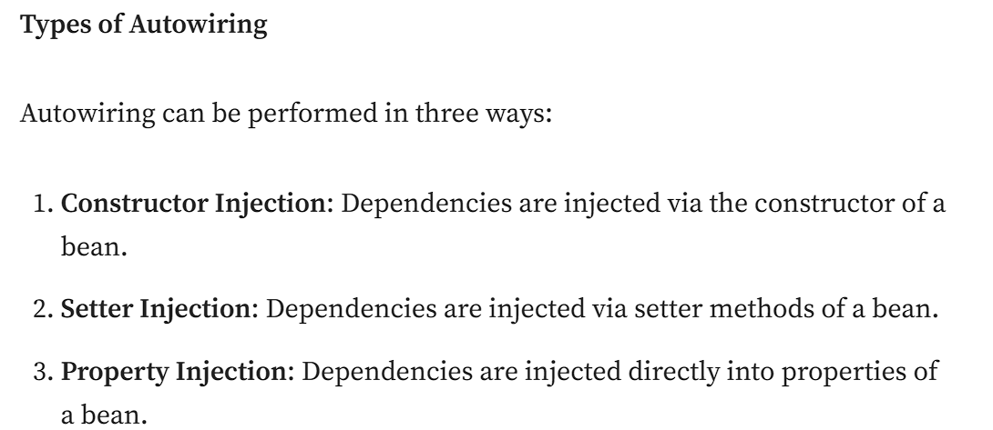
Autowiring in Spring
Autowiring is a powerful feature in Spring that automatically injects dependencies into Spring-managed beans.
It reduces the need for explicit configuration and makes the codebase more maintainable.

